Slide 1
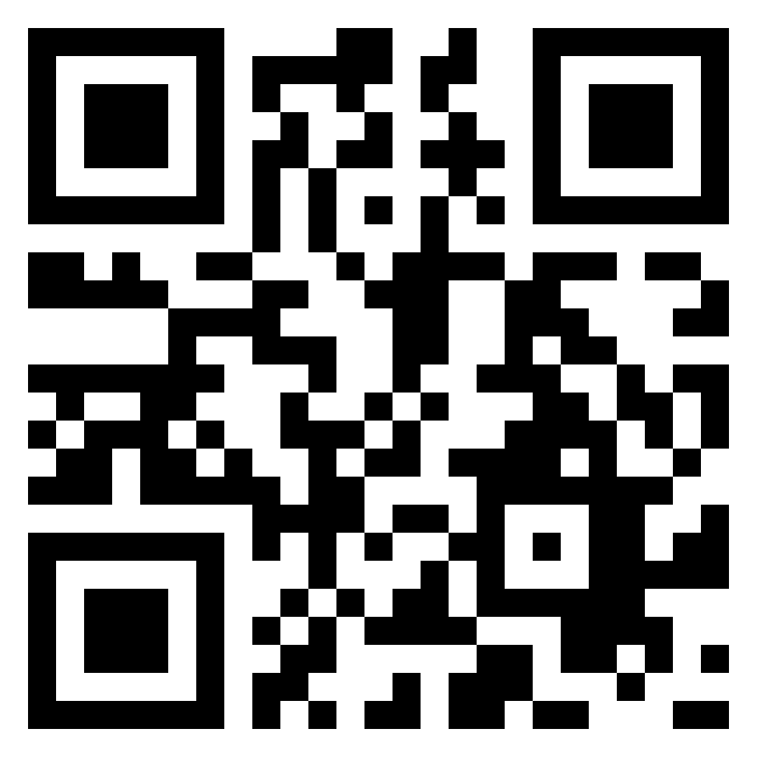
Cyber Security and Society: a pre-war reality check
Bert Hubert / bert@hubertnet.nl
https://berthub.eu/prewar

Slide 2
First some important words from Donald T.

Slide 3
“I know it sounds devastating but we have to get used to the fact that a new era has begun: the pre-war era.”

Slide 4
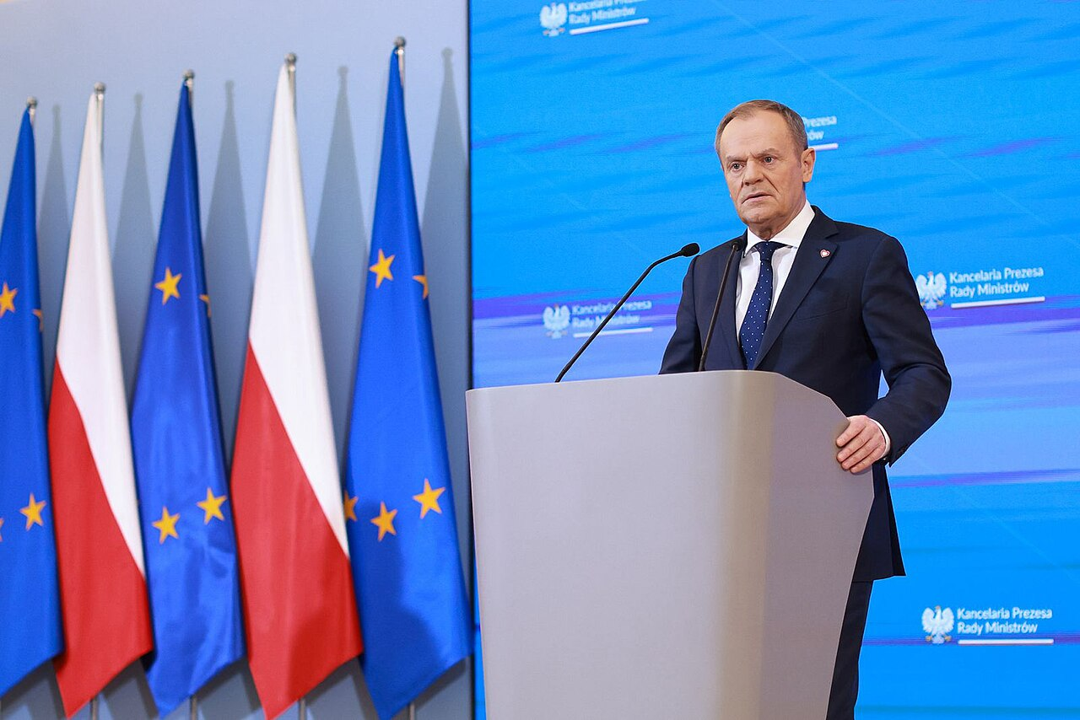
“When Donald Tusk was Polish prime minister for the first time, from 2007 to 2014, he said few other European leaders beyond Poland and the Baltic states realised Russia was a potential threat.”
Notes:
https://edition.cnn.com/2024/03/29/europe/poland-tusk-europe-pre-war-russia-ukraine-intl/index.html

Slide 5










Notes:
Things I have done - only interesting to put my (strong) claims on later pages in context. I failed in my studies of physics, launched an unsuccessful startup (PowerDNS), and when that did not go well joined Dutch intelligence & security agency AIVD. From there I went on to develop software for police and intelligence agencies, while PowerDNS went on. After Fox-IT I did DNA research in Delft again, and then focused on PowerDNS again. After that, I became a regulator of Dutch intelligence services for 2 years. During this time I managed to get my DNA paper published in Nat. Scientific Data. https://www.nature.com/articles/s41597-022-01179-8

Slide 6
Notes:
This committee that regulates the Dutch intelligence and security agencies is/was unique in that it employs technical specialists at the heart of a place that in most countries only features lawyers. If you work at a department that studies policy and technology, this should warm your heart! https://www.politico.eu/article/intelligence-watchdog-bert-hubert-netherlands-hacking-cyber-law/ has some stuff on this committee.

Slide 7

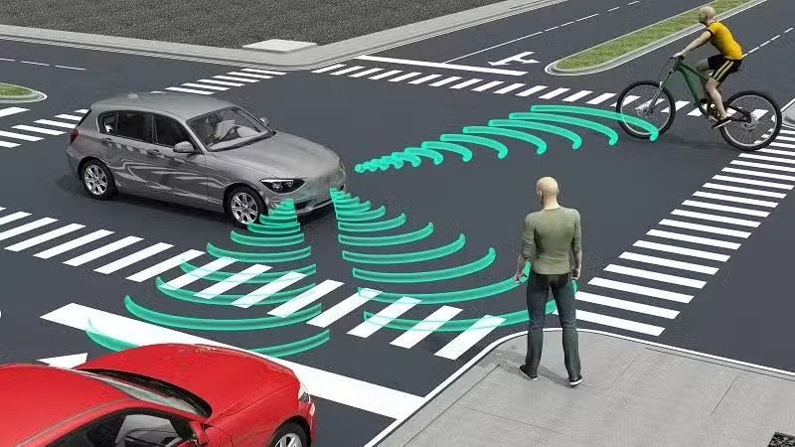
https://www.drive.com.au/news/tesla-hit-and-run-driver-to-stand-trial-for-crash-blamed-on-autopilot/

Slide 8

Cyber Security Act
Cyber Resilience Act
Cyber Solidarity Act
Digital Operational Resilience Act (DORA)
NIS2 Directive
Product Liability Directive
.. and they aren’t done yet
Notes:
https://berthub.eu/articles/posts/eu-cra-secure-coding-solution/

Slide 9
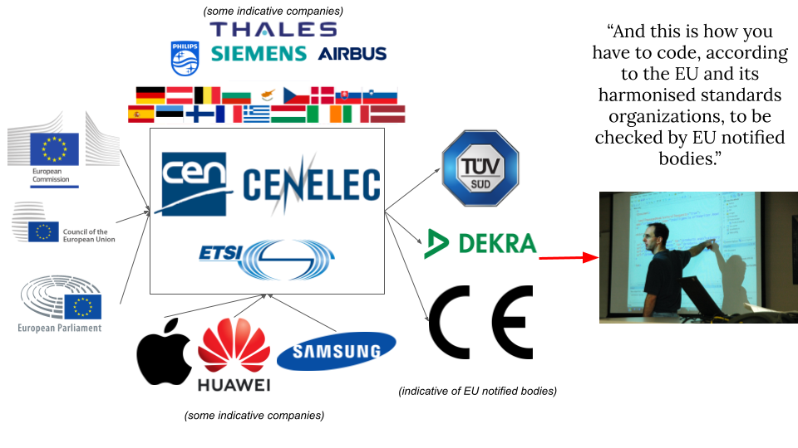

Slide 10
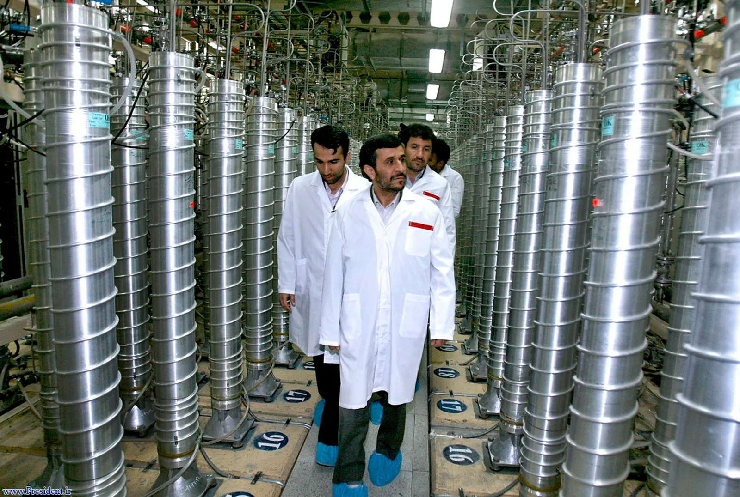

Slide 11
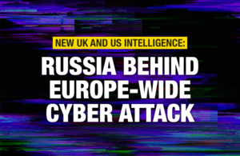
On 24 February, a cyber-attack against Viasat began approximately 1 hour before Russia launched its major invasion of Ukraine. Although the primary target is believed to have been the Ukrainian military, other customers were affected, including personal and commercial internet users. Wind farms in central Europe and internet users were also affected.
Viasat has said that “tens of thousands of terminals have been damaged, made inoperable and cannot be repaired.”
Notes:
https://en.wikipedia.org/wiki/Viasat_hack

Slide 12
When times are bad, you are (much more) on your own!
ROBUST: Does not fall over by itself
LIMITED/KNOWN DEPENDENCIES: Does not need too much unknown stuff too far away
OWNERSHIP/UNDERSTANDING: If things break, you can improvise or fix things

Slide 13
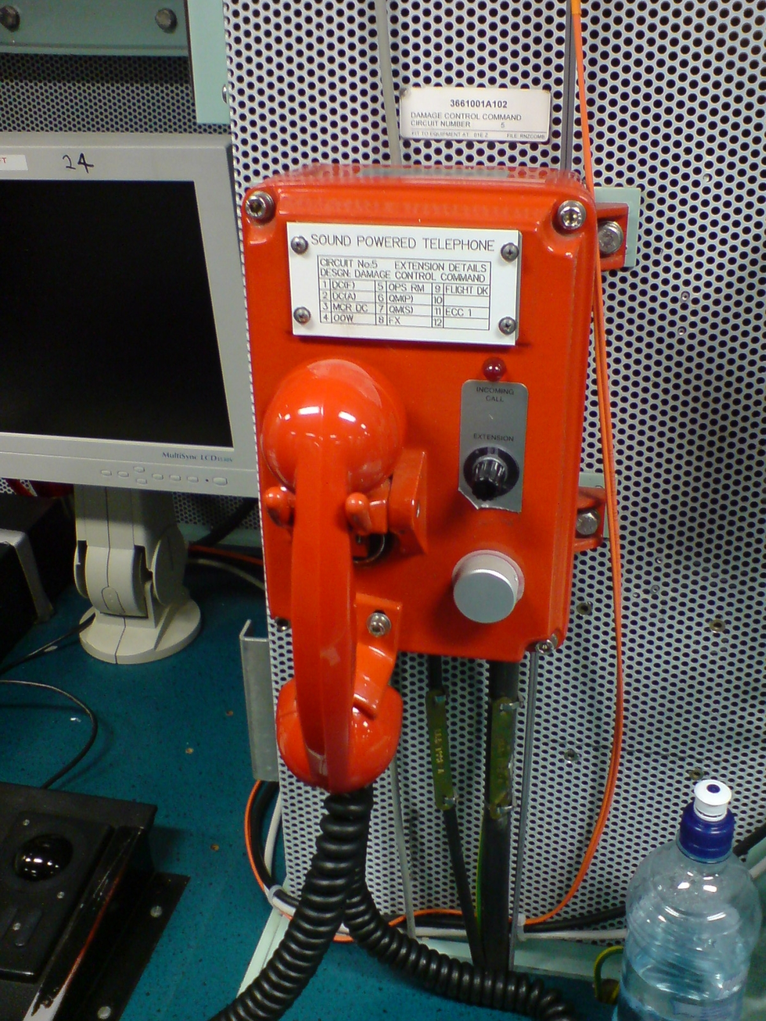
“Many different types of equipment have attempted, but have largely failed, to replace the incredibly simple sound-powered telephones on ships. Due to the rugged, reliable and power-free nature of this equipment, it remains in use on all US military vessels.”
Notes:
https://en.wikipedia.org/wiki/Sound-powered_telephone

Slide 14
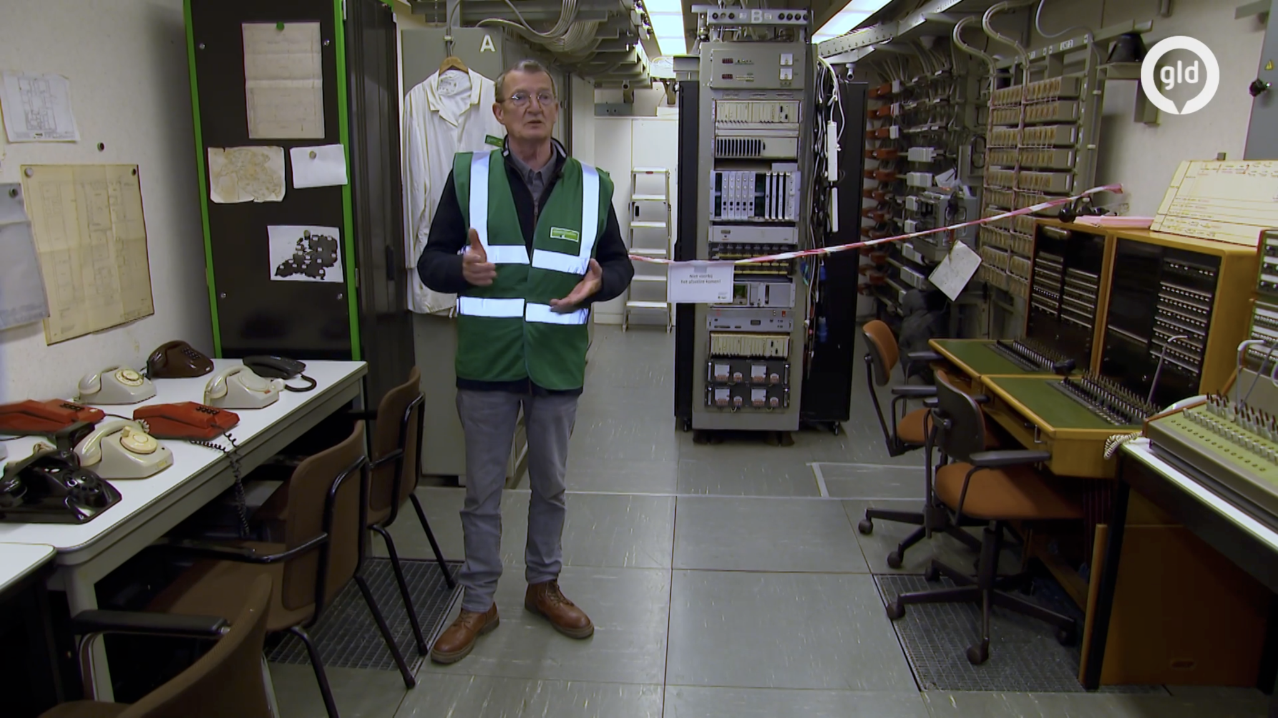
Notes:
https://www.gld.nl/nieuws/8135427/kijken-mag-nu-want-geheime-atoombunker-voldoet-alleen-nog-als-erfgoed

Slide 15

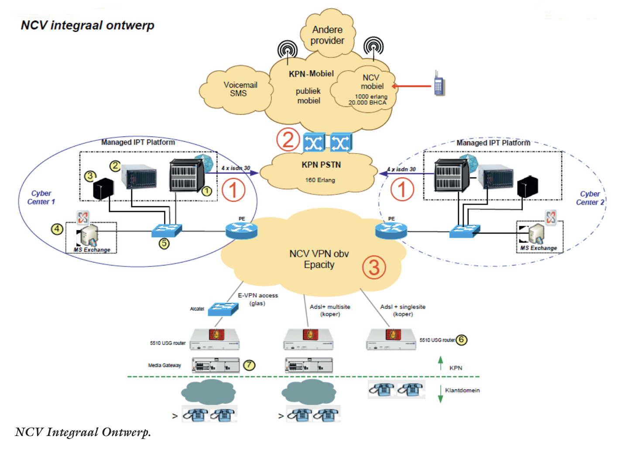
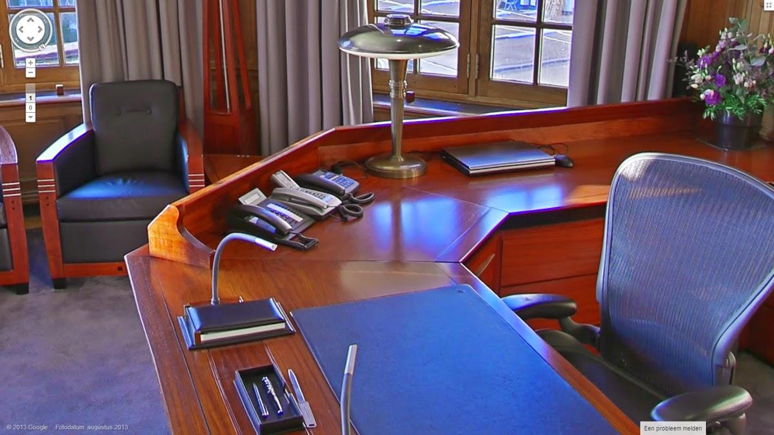

Slide 16
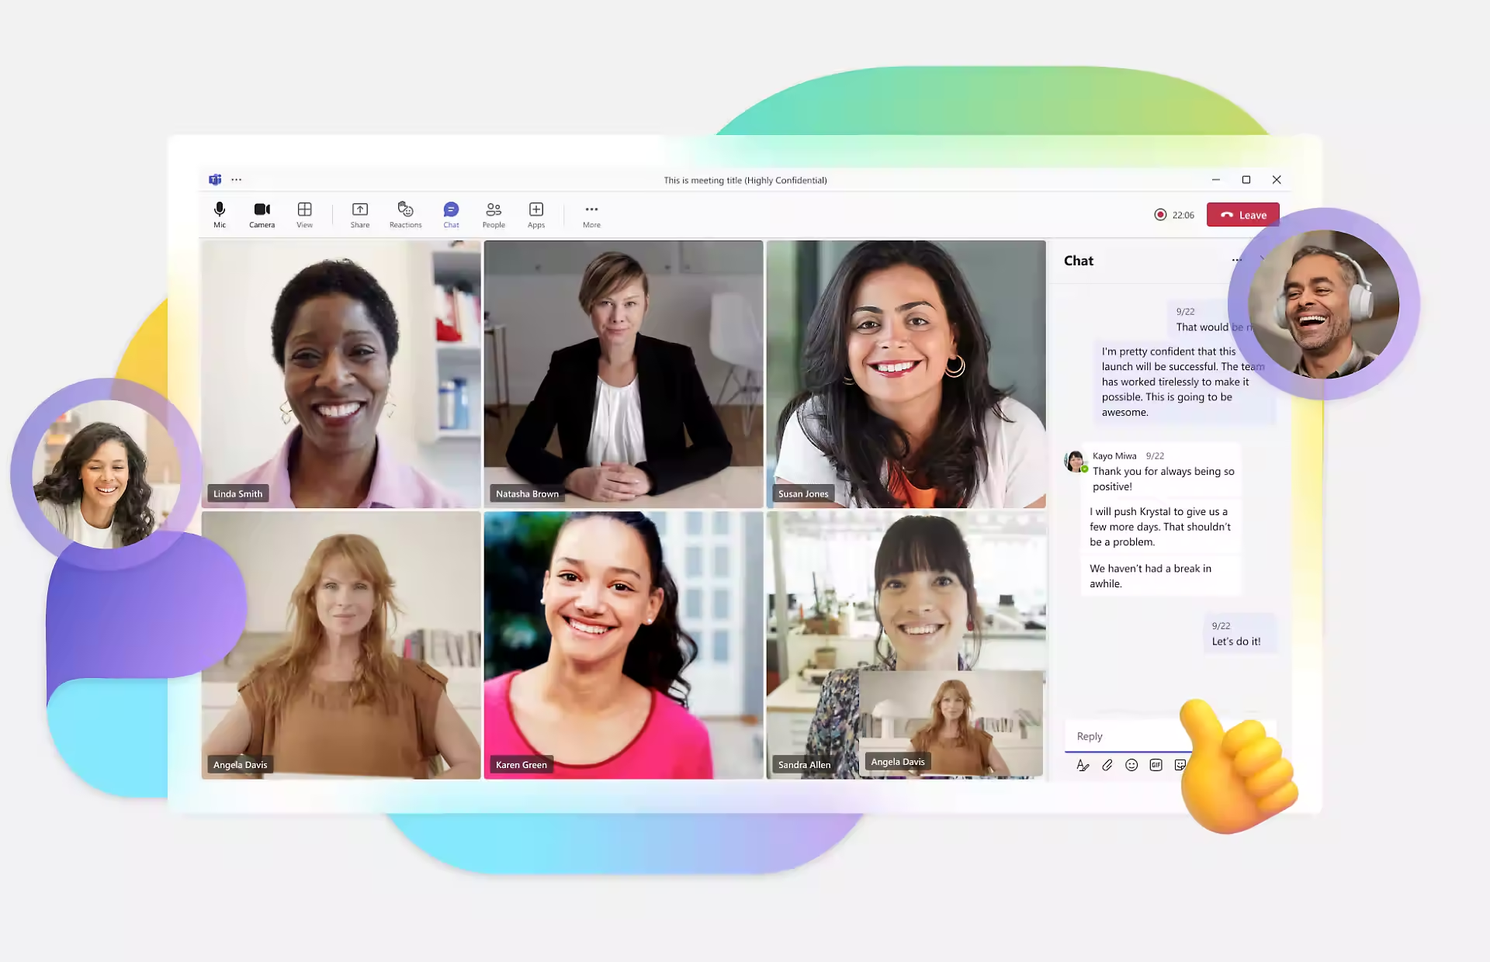

Slide 17


Slide 18



Slide 19
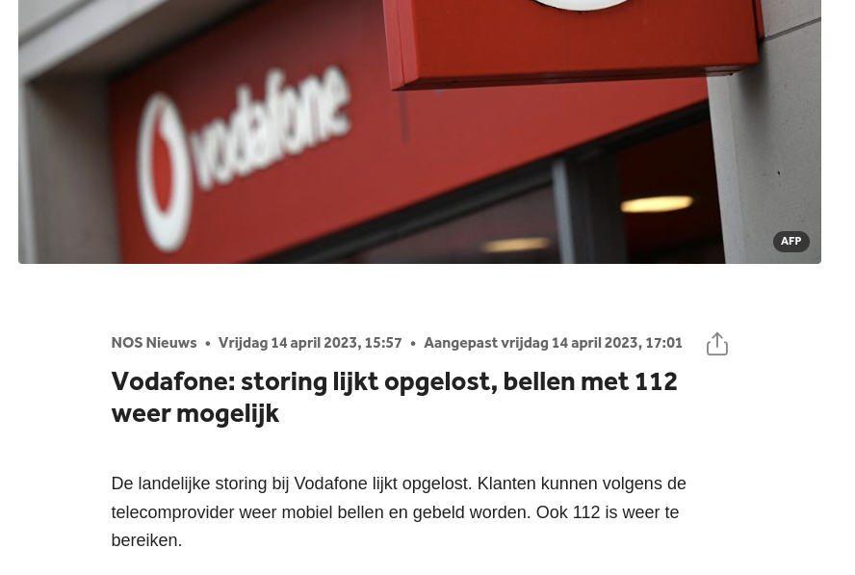

Slide 20
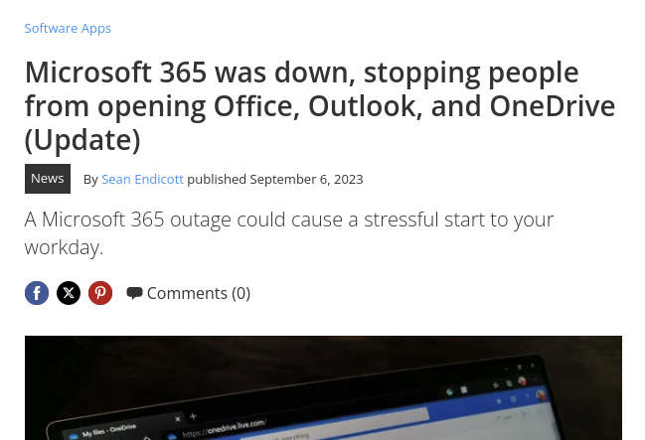

Slide 21
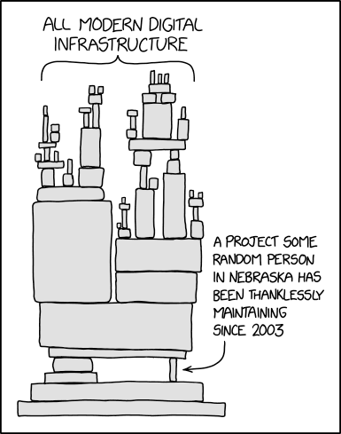
The stack is too high!

Slide 22
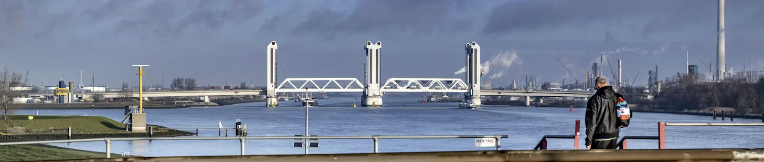

Slide 23


Slide 24
So where are we?

Slide 25
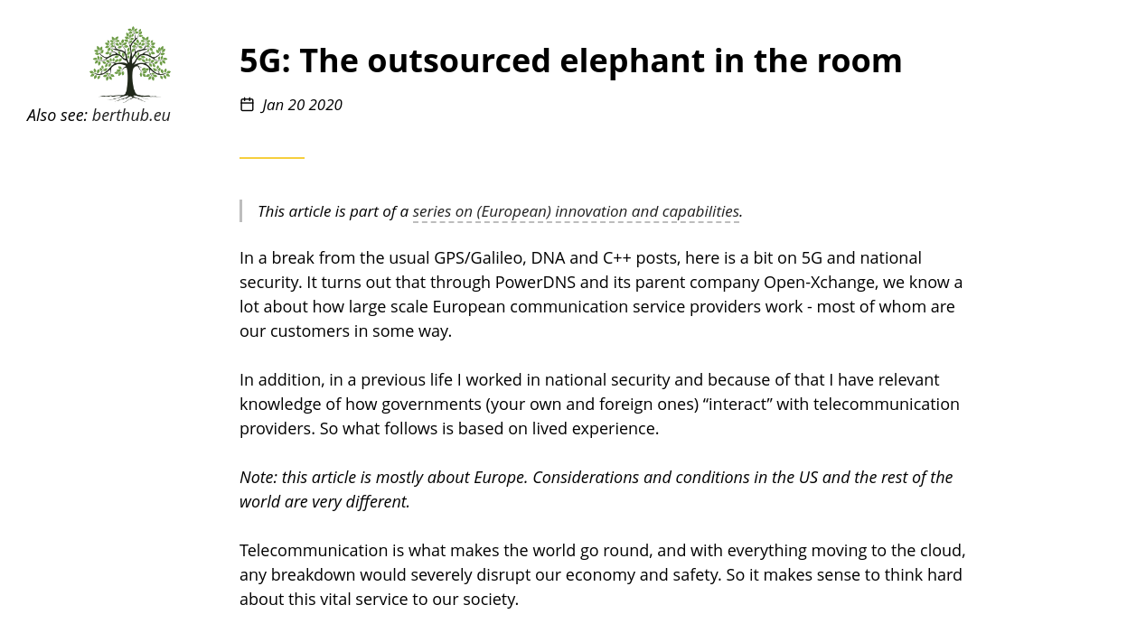
Notes:
https://berthub.eu/articles/posts/5g-elephant-in-the-room/

Slide 26
‘Any worries about “the Chinese” being able to disrupt our communications through backdoors ignore the fact that all they’d need to do to disrupt our communications.. is to stop maintaining our networks for us!’ (2020)
Notes:
https://berthub.eu/articles/posts/5g-elephant-in-the-room/

Slide 27




Slide 28
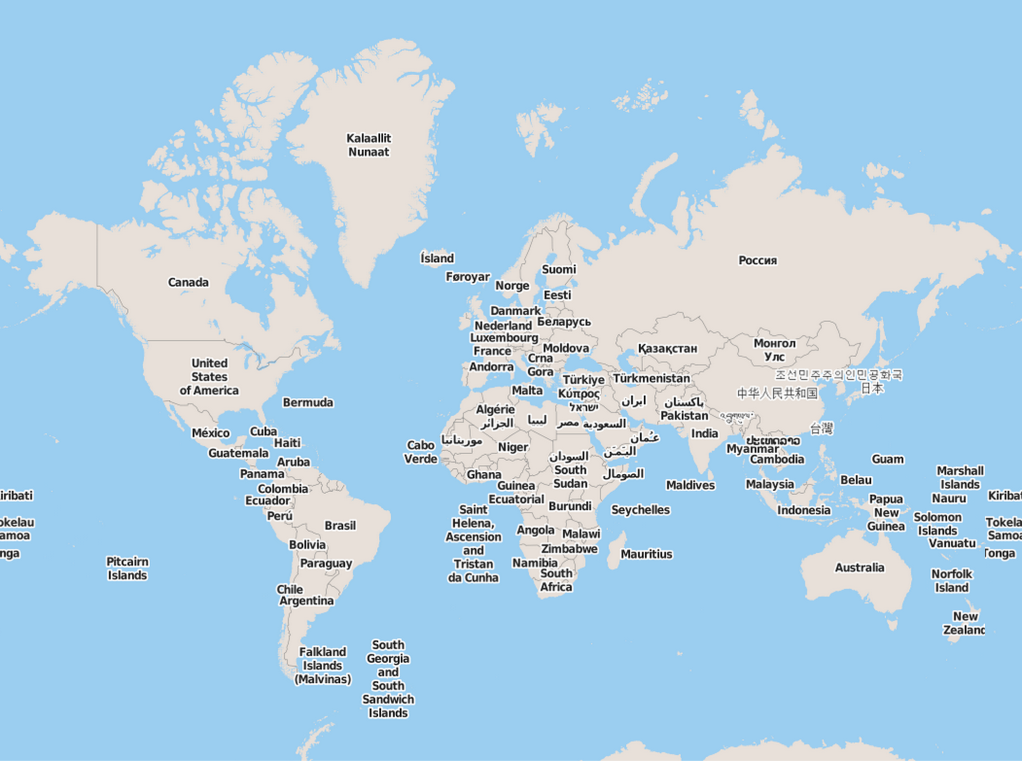





Slide 29
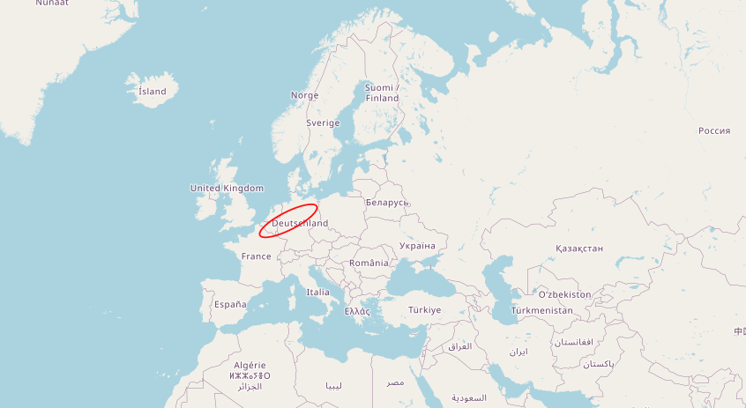

Slide 30

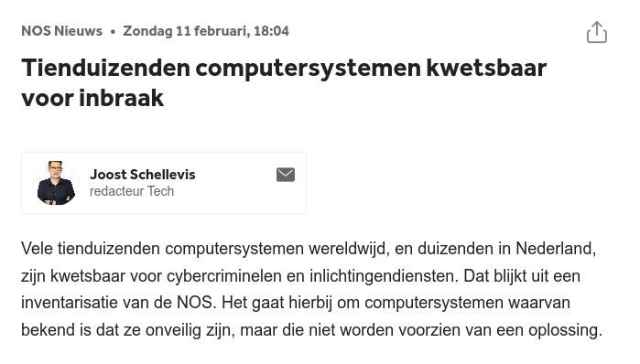
Notes:
Waarom moet JOOST dit doen?? Dit is heel laaghangend fruit. Te vinden als bijbaan. En toch blijft het maar zo.

Slide 31

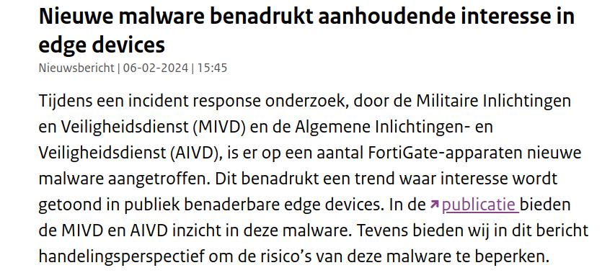
Notes:
Een van de zeldzame gevallen waarin de Nederlandse overheid bekende gehackt te zijn. Wel goed dat ze dit deden, en ook de leverancier bekend maakten.

Slide 32
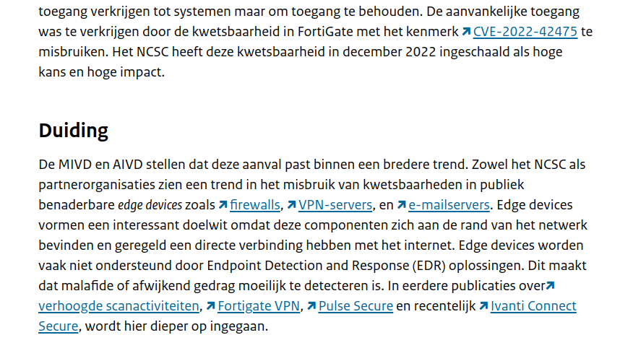
Notes:
Men noemt hier diverse andere leveranciers waar je mee op moet passen. Zijn klinkende namen.

Slide 33
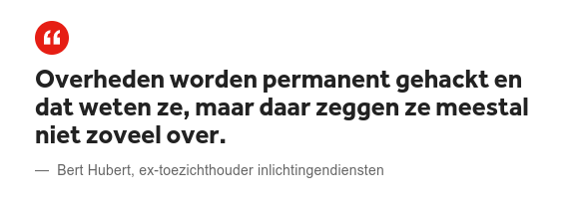
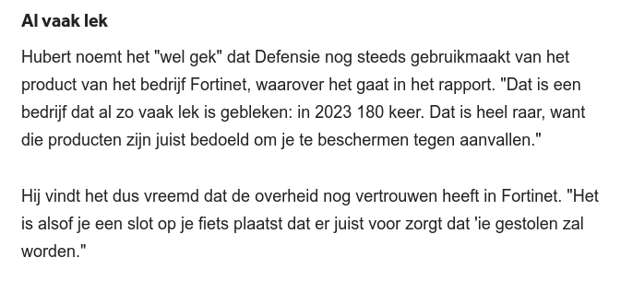
Notes:
Vreemd genoeg blijft iedereen deze lekke spullen kopen.

Slide 34
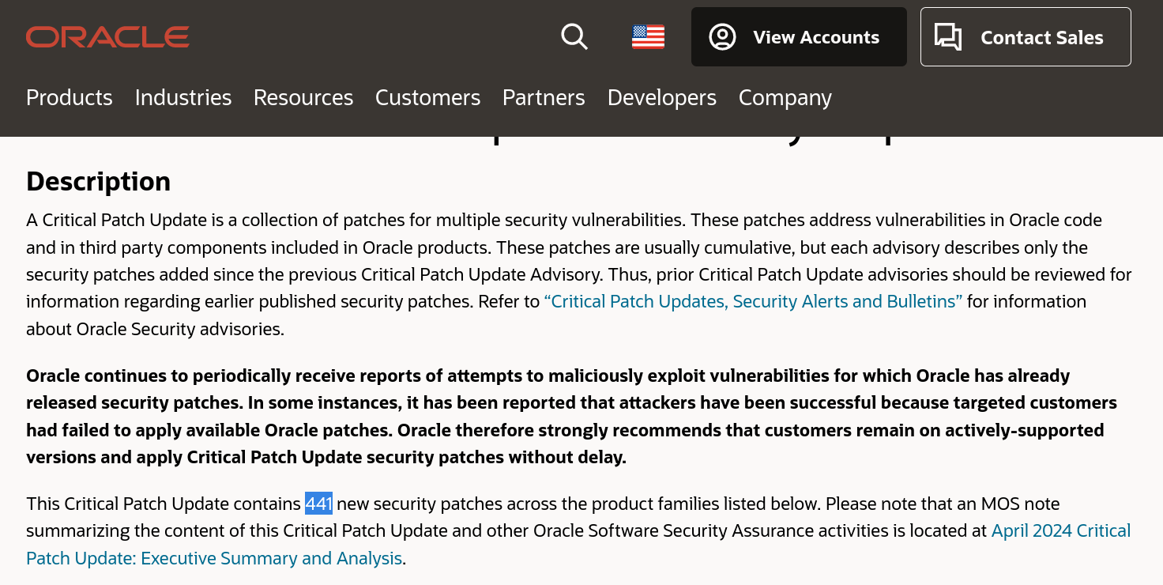

Slide 35
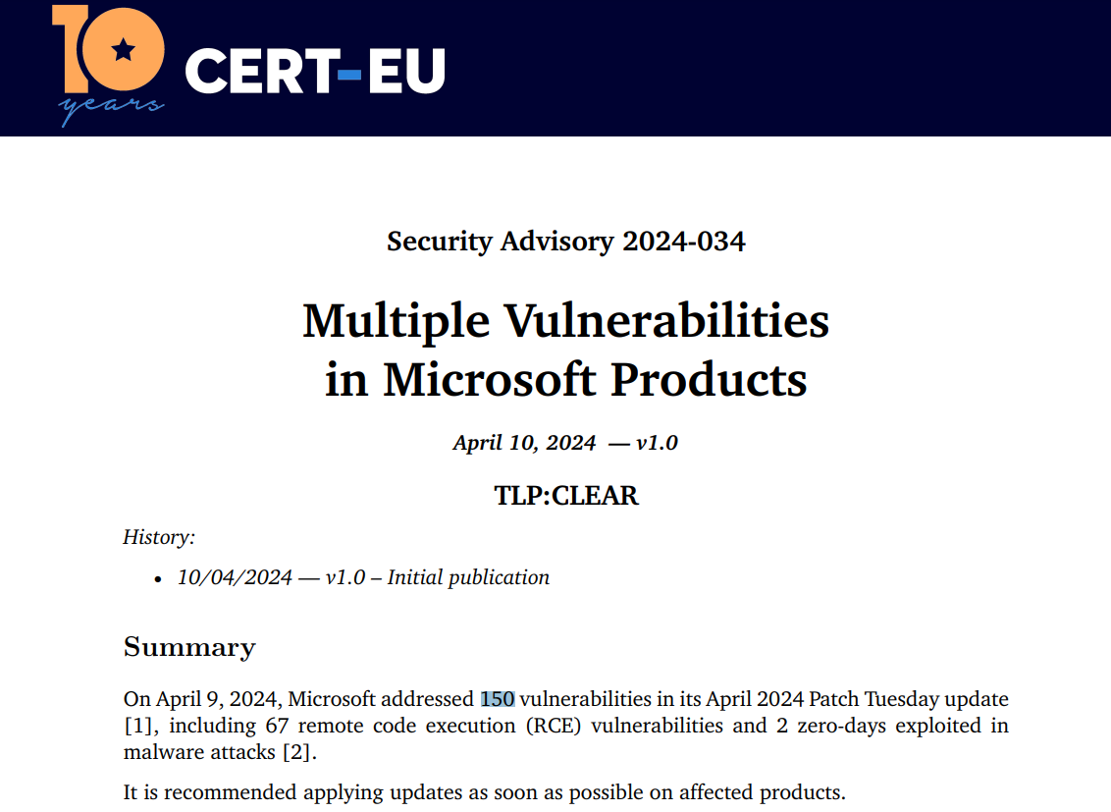

Slide 36
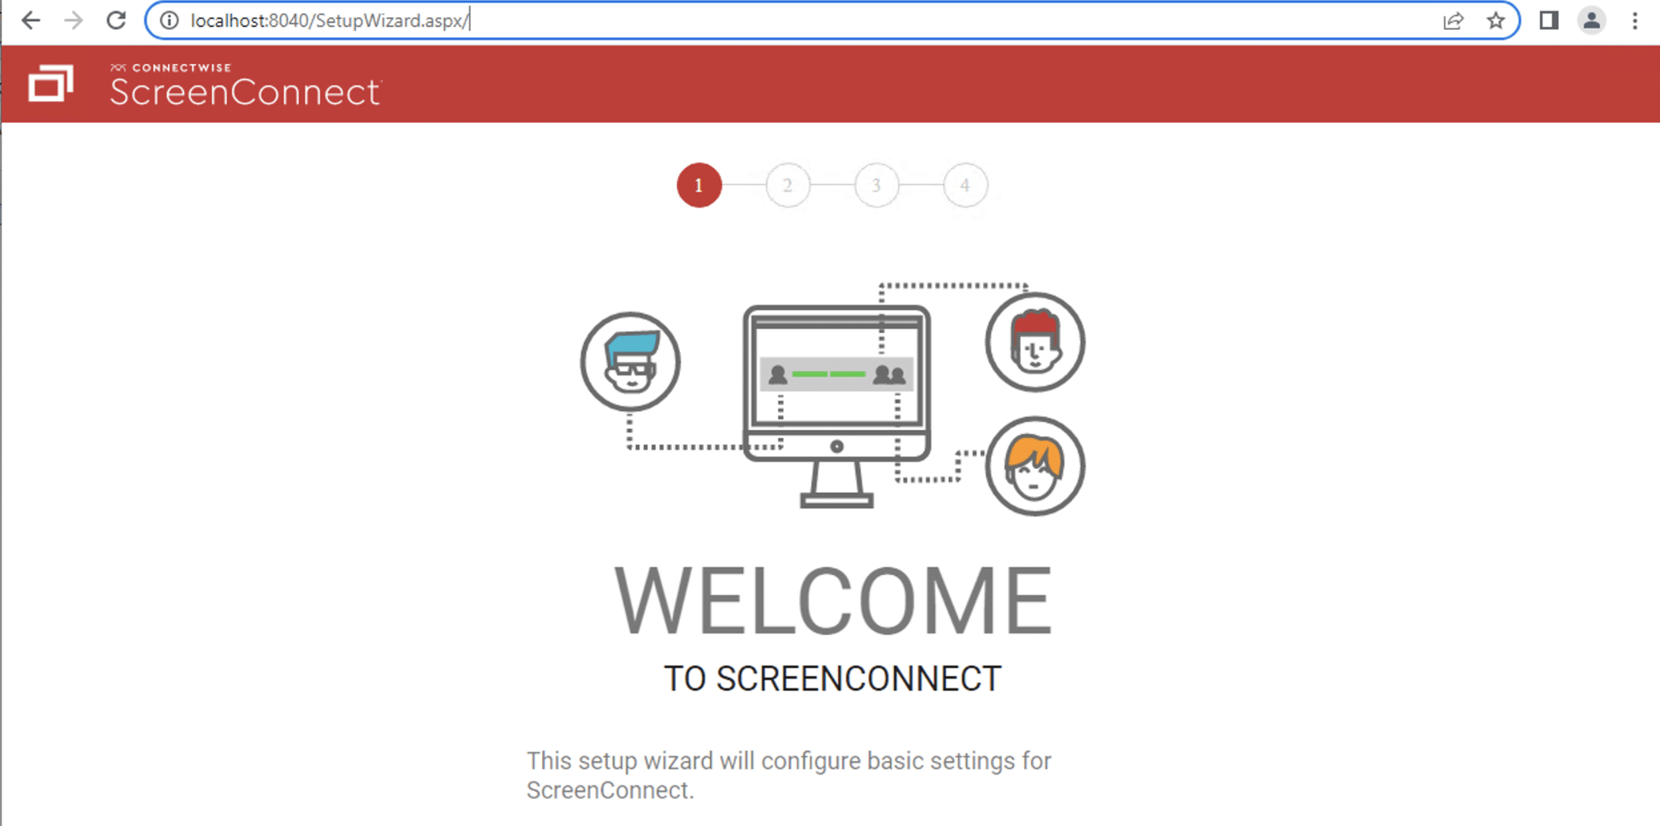
Notes:
Deze software wordt gebruikt door helpdesks om computers op afstand mee over te nemen. Het bleek dat als je een “/” toevoegde bovenin je het wachtwoord mocht veranderen. En zo kan je een heel bedrijf overnemen. En een / toevoegen is geen heel bijzondere hacktechniek.

Slide 37
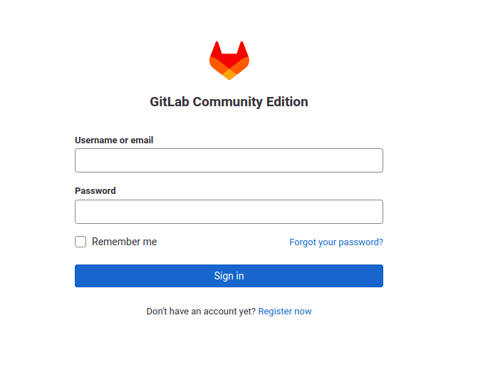
bert@hubertnet.nl
Notes:
In GitLab bewaren bedrijven en overheden de broncode van applicaties. Als je je wachtwoord vergeten bent kan je hier een link opvragen om een nieuw wachtwoord in te stellen. Maar..

Slide 38
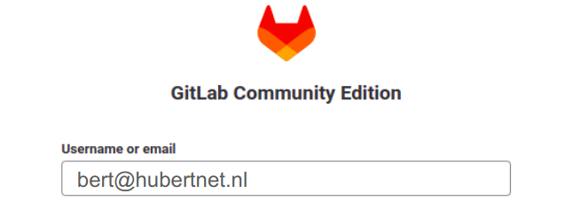
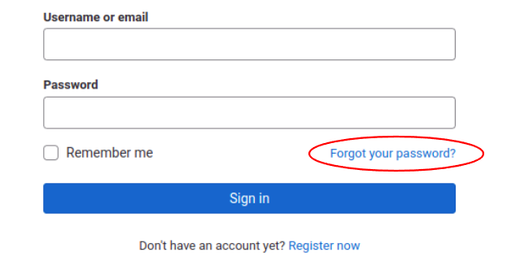
Nog een keer!
nare-hacker@example.com
KLIK!
Notes:
Maar bleek dat als je TWEE email adressen opgaf het systeem het eerste email adres controleerde of het de goeie was. En daarna stuurde hij de “reset je wachtwoord link” naar het tweede email adres. Wat dan van een hacker kan zijn. Super spannende hack techniek.

Slide 39
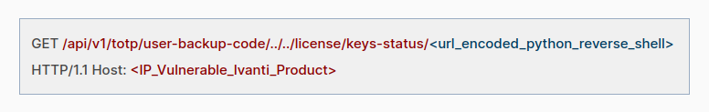
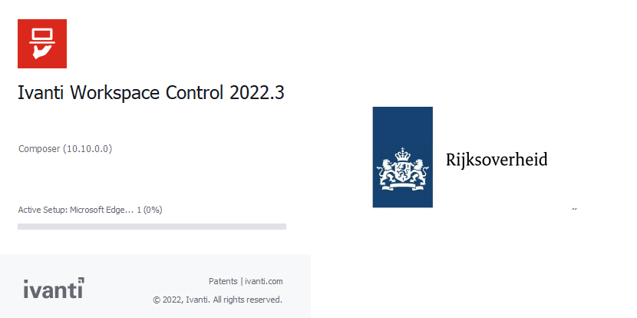
Notes:
https://www.picussecurity.com/resource/blog/ivanti-cve-2023-46805-and-cve-2024-21887-zero-day-vulnerabilities - inmiddels verboden door de US overheid, maar wij gaan er mee door. https://www.cisa.gov/news-events/news/cisa-issues-emergency-directive-requiring-federal-agencies-mitigate-ivanti-connect-secure-and-policy - je komt pas bij Ivanti als je al 1 wachtwoord ingevuld hebt, maar daarna is het prijsschieten.

Slide 40
Perhaps move to the cloud then?

Slide 41
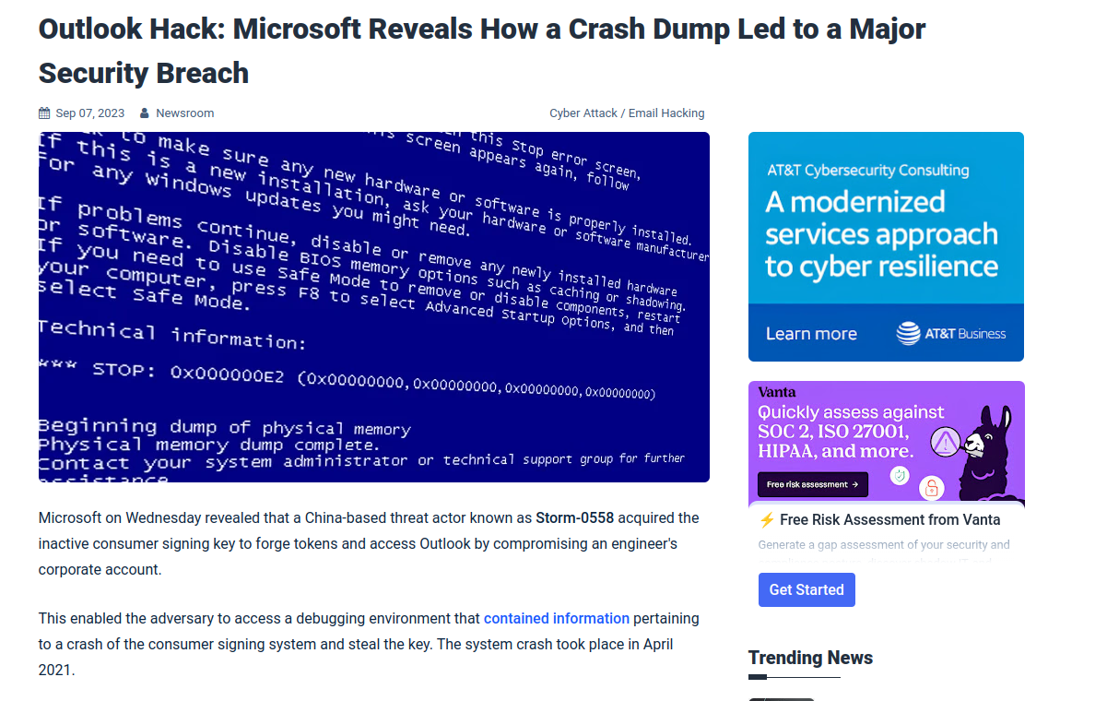
Notes:
Oeps. Microsoft vertelde hier dat hackers met een super geavanceerde truc binnengekomen waren, via een “crash dump”.

Slide 42
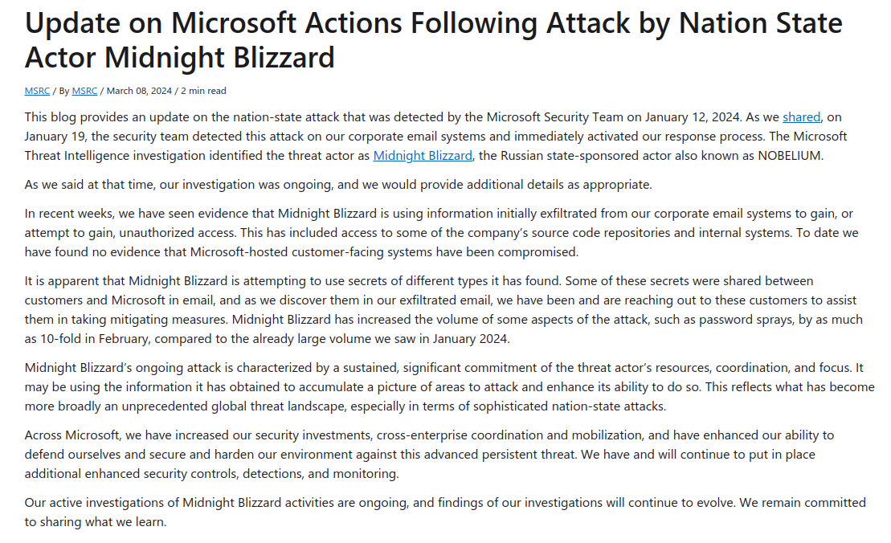
Notes:
Microsoft laat weten dat ze nog steeds gehacked zijn.

Slide 43
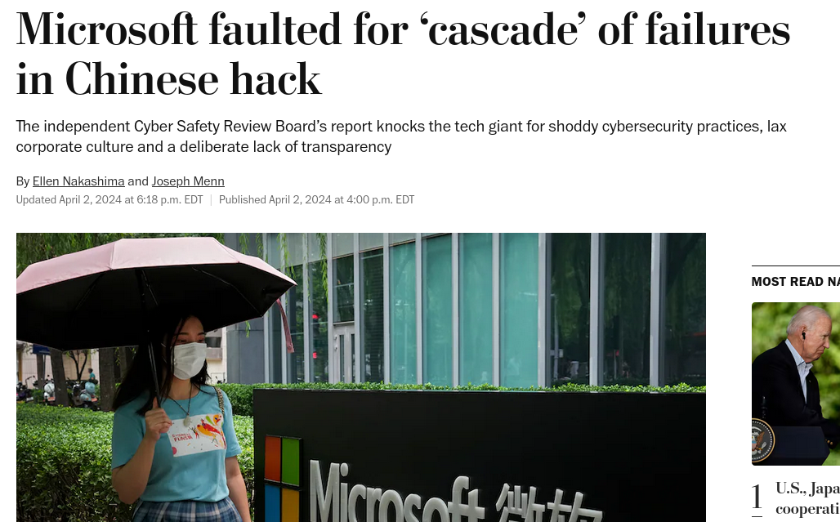
Notes:
https://www.washingtonpost.com/national-security/2024/04/02/microsoft-cyber-china-hack-report/

Slide 44
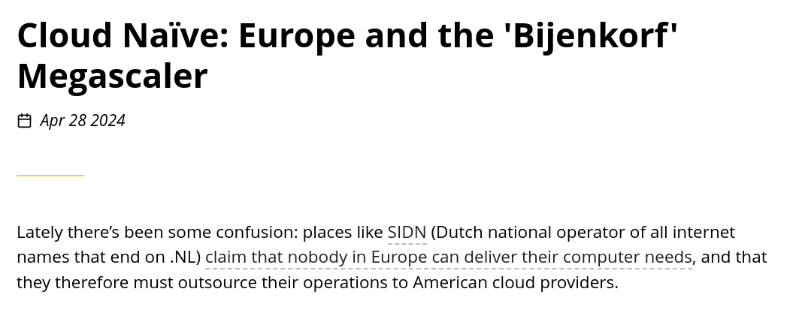

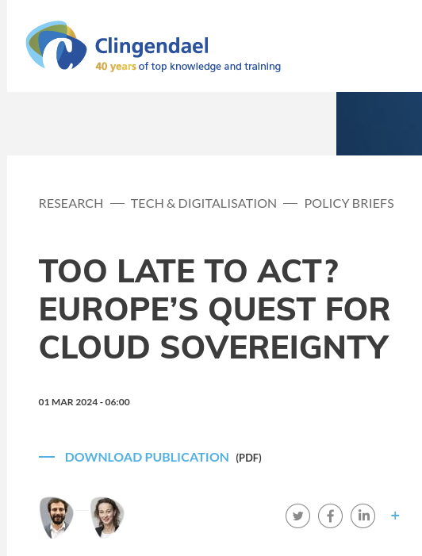
Notes:
https://www.clingendael.org/publication/too-late-act-europes-quest-cloud-sovereignty https://berthub.eu/articles/posts/cloud-naive-europe-and-the-megascaler/

Slide 45
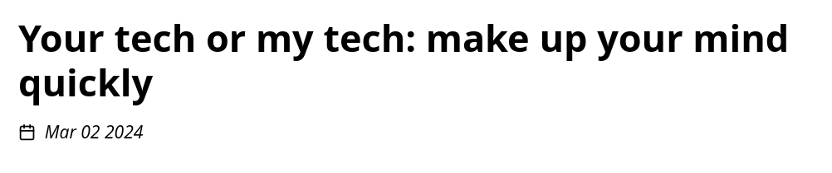
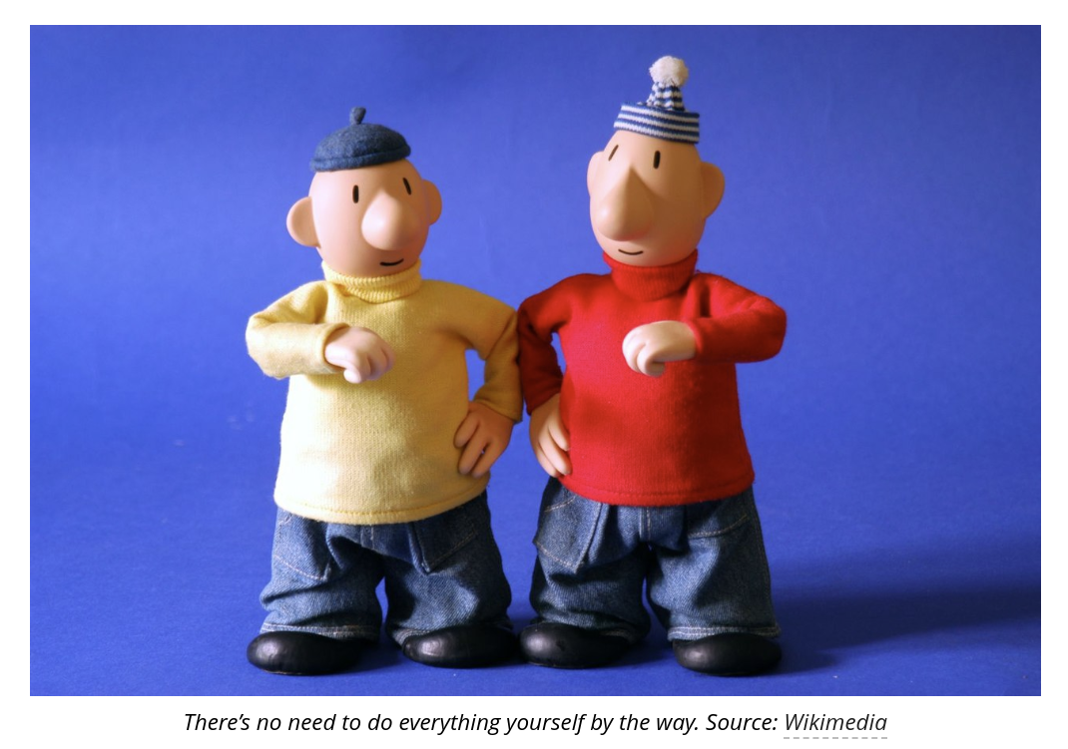
“You end up in a situation where everyone who loves IT has left, and as an employer you have also become very unattractive to people who have actual skills.”
Notes:
https://berthub.eu/articles/posts/your-tech-my-tech/

Slide 46
Why is this happening?

Slide 47
We can’t go on like this!

Slide 48
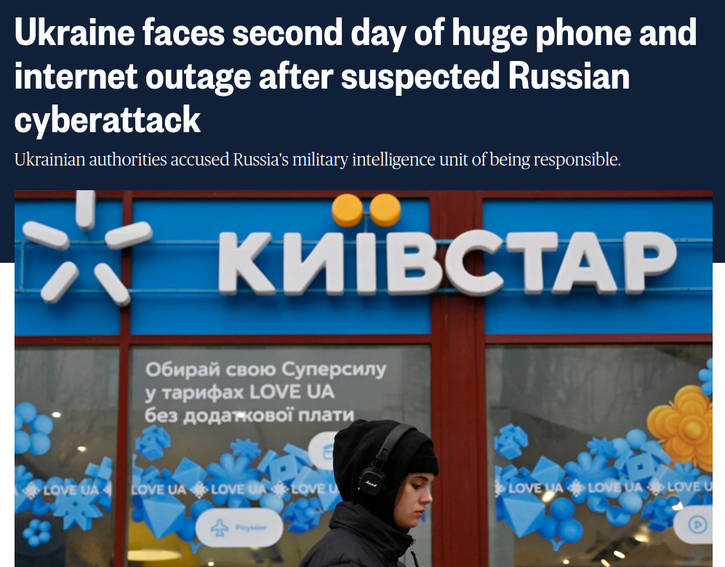
December 2023

Slide 49
When times are bad, you are (much more) on your own!
(no one has time for you!)
ROBUST: Does not fall over by itself
LIMITED/KNOWN DEPENDENCIES: Does not need too much unknown stuff too far away
OWNERSHIP/UNDERSTANDING: If things break, you can improvise or fix things

Slide 50
Is there a way back?

Slide 51
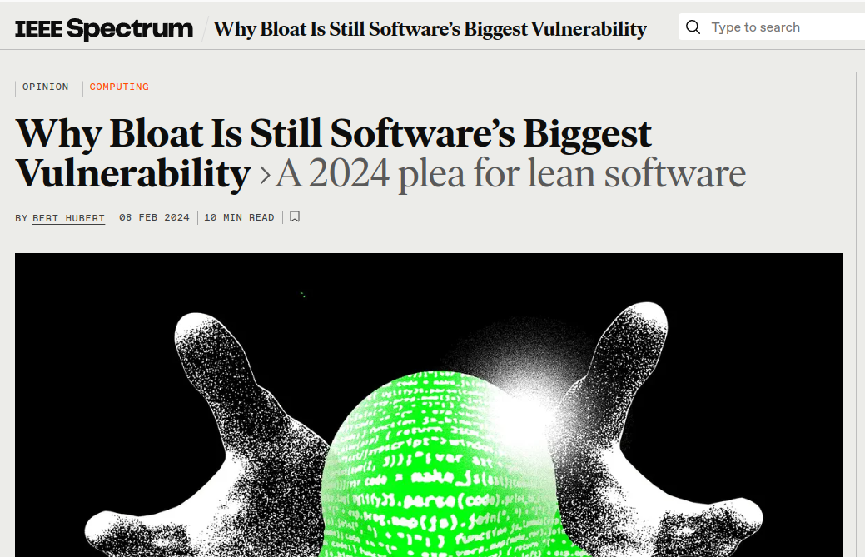

Slide 52
Summary
The systems that support our daily lives are way way too complex & fragile
And getting more complex
Maintenance is moving ever further away from us
As is understanding
Our own skills are wilting, we are no longer able to control our infrastructure
Now imagine a war where you need help from everyone else
We get this because non-technical people make economic choices
I don’t know how we can fix this

Slide 53
Cyber Security and Society: a pre-war reality check
Bert Hubert / bert@hubertnet.nl
https://berthub.eu/prewar

